Slide 1

OCNeX
OmniFlux Cryosphere with NeuroGrid Prognostic Nexis
Team Nexora
OCNeX represents a transformative platform that fuses artificial intelligence, multi-temporal satellite analytics, and predictive environmental modeling to deliver unparalleled insights into both local and global ecological dynamics. Designed to bridge terrestrial observations with planetary-scale datasets, the system empowers users to monitor, analyze, and forecast critical environmental phenomena, including carbon emissions, deforestation/reforestation trends, cryospheric changes, sea level rise, and weather variability. By leveraging AI-driven prognostic models, OCNeX transcends conventional monitoring systems, providing predictive intelligence capable of identifying emerging ecological risks, mapping future emission hotspots, and projecting the evolution of Earth's cryosphere. The platform integrates data streams into a unified interface, offering real-time visualization and actionable insights for stakeholders ranging from scientists and policymakers to urban planners and environmental researchers

Slide 2







Six Core Capabilities
Carbon Emissions
Forest Dynamics
Global CO₂, NO₂, CH₄ monitoring with 10-day trend forecasts.
NDVI-based deforestation and reforestation tracking per region.
Smart Control
Cryosphere
IoT-integrated cooling and agricultural automation systems.
Glacier mass balance and ice sheet retreat predictions.
Weather
Sea Level
Temperature, precipitation, and extreme event forecasting.
Ocean height monitoring with future rise projections.

Slide 3

Project resources:
carbon emission - https://ocov2.jpl.nasa.gov/
deforestation and reforestation - https://maxar.skyfi.com
sea level - https://marine.copernicus.eu/
glacier - https://www.earthdata.nasa.gov/data/projects/glims
weather and temperature forecasting - NASA POWER | Homepage

Slide 4
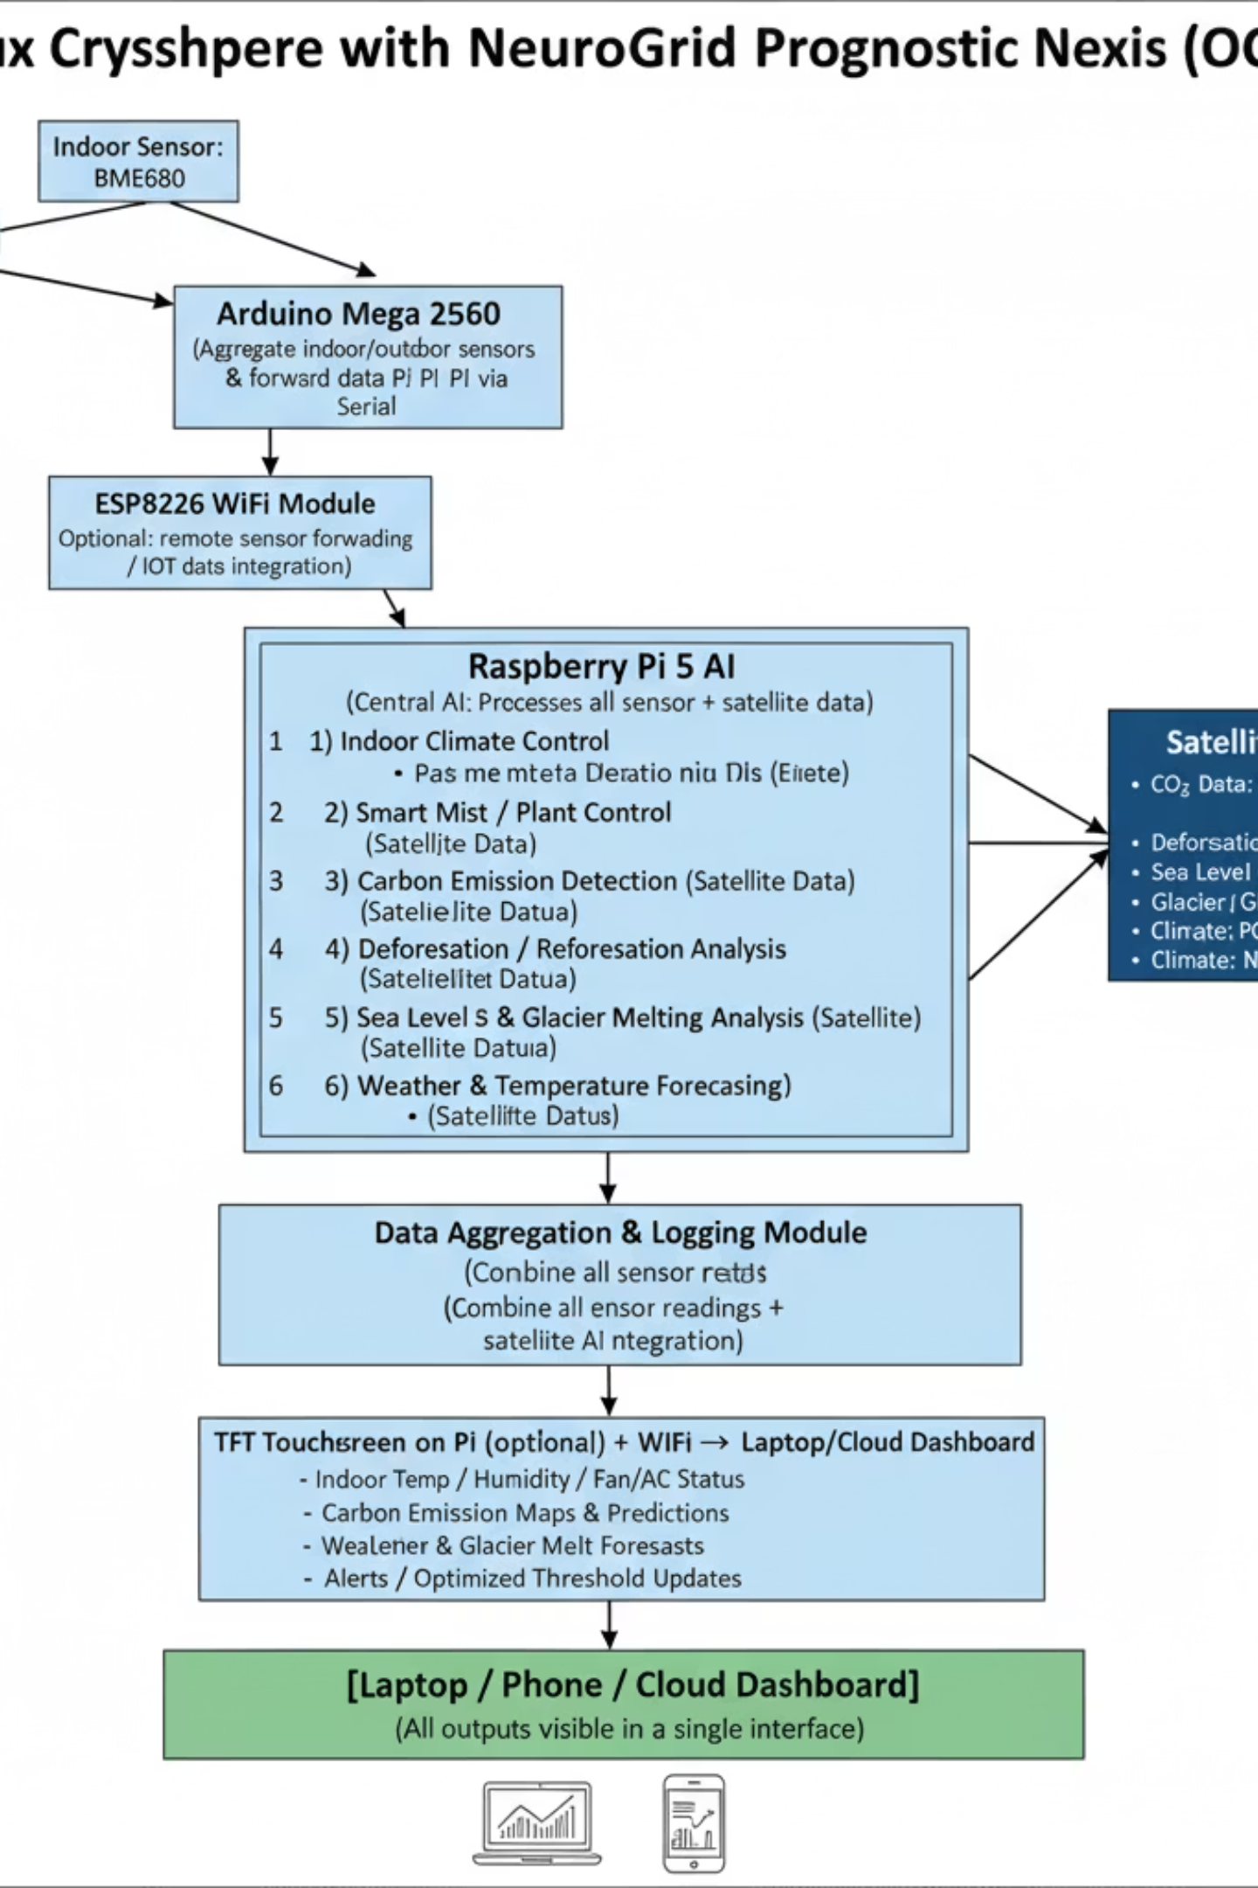
Block Diagram

Slide 5
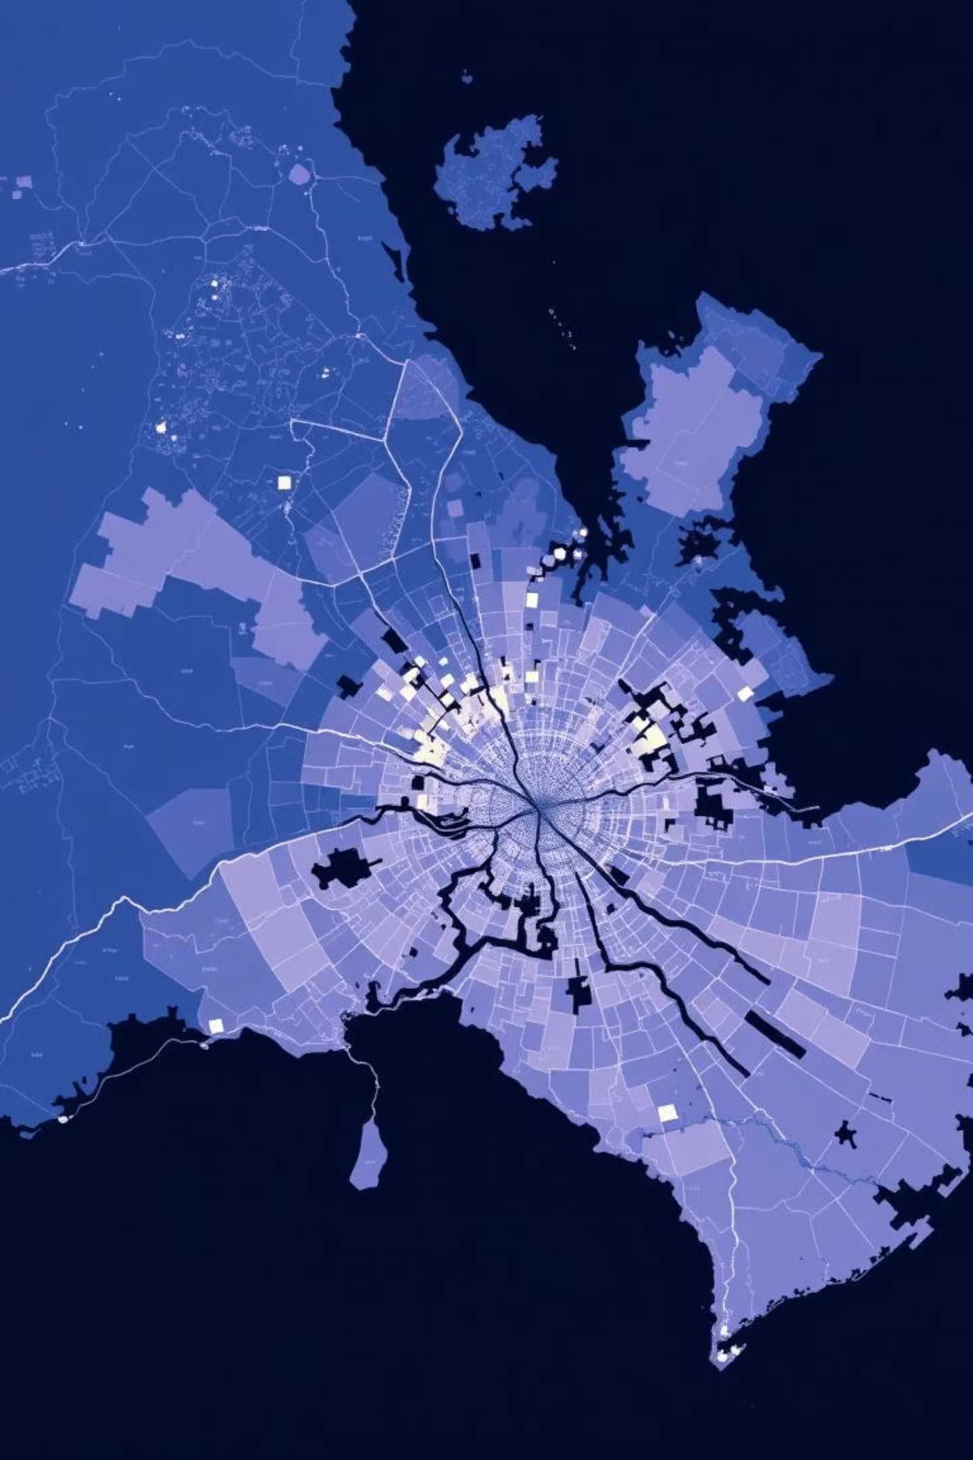
Carbon Emission Monitoring
Data Pipeline
Key Outputs
Download satellite data every 5 days from NASA, ESA, Copernicus
30-day emission averages by region
10-day predictive forecasts
Store CO₂, NO₂, CH₄ in CSV/NetCDF format
Global heat visualization maps
Actionable mitigation insights
Apply LSTM/regression models for trend analysis
Generate heat maps and emission hotspot alerts

Slide 6
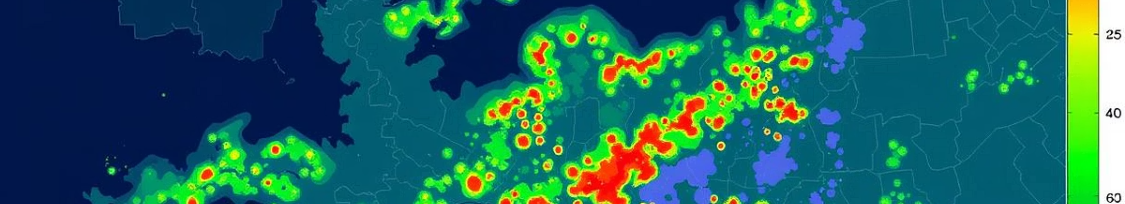
Forest & Deforestation Intelligence
OCNeX processes Sentinel-2 satellite imagery to compute NDVI (Normalized Difference Vegetation Index), comparing historical and current forest cover to identify loss and restoration zones at granular per-country resolution.
1
Download Sentinel-2 Bands
2
Calculate NDVI
Red (B04) and NIR (B08) from Copernicus Hub
NDVI = (NIR − RED) / (NIR + RED)
3
Detect Change
4
Visualize & Alert
Compare present vs. historical NDVI to flag deforestation or reforestation
Generate heatmaps and send alerts for critical forest loss regions

Slide 7

Cryosphere & Sea Level Prediction
LSTM neural networks synthesize decades of satellite data to forecast glacier retreat, ice sheet dynamics, and sea level rise—critical for climate adaptation and water resource planning.
Glacier Monitoring
Sea Level Analysis
Track glacier mass balance
Download SSH data from Copernicus Marine
Monitor ice sheet retreat rates
Predict future melt patterns
Train LSTM on historical trends
Assess water availability impact
Project rise over 10+ years
Support coastal planning decisions

Slide 8
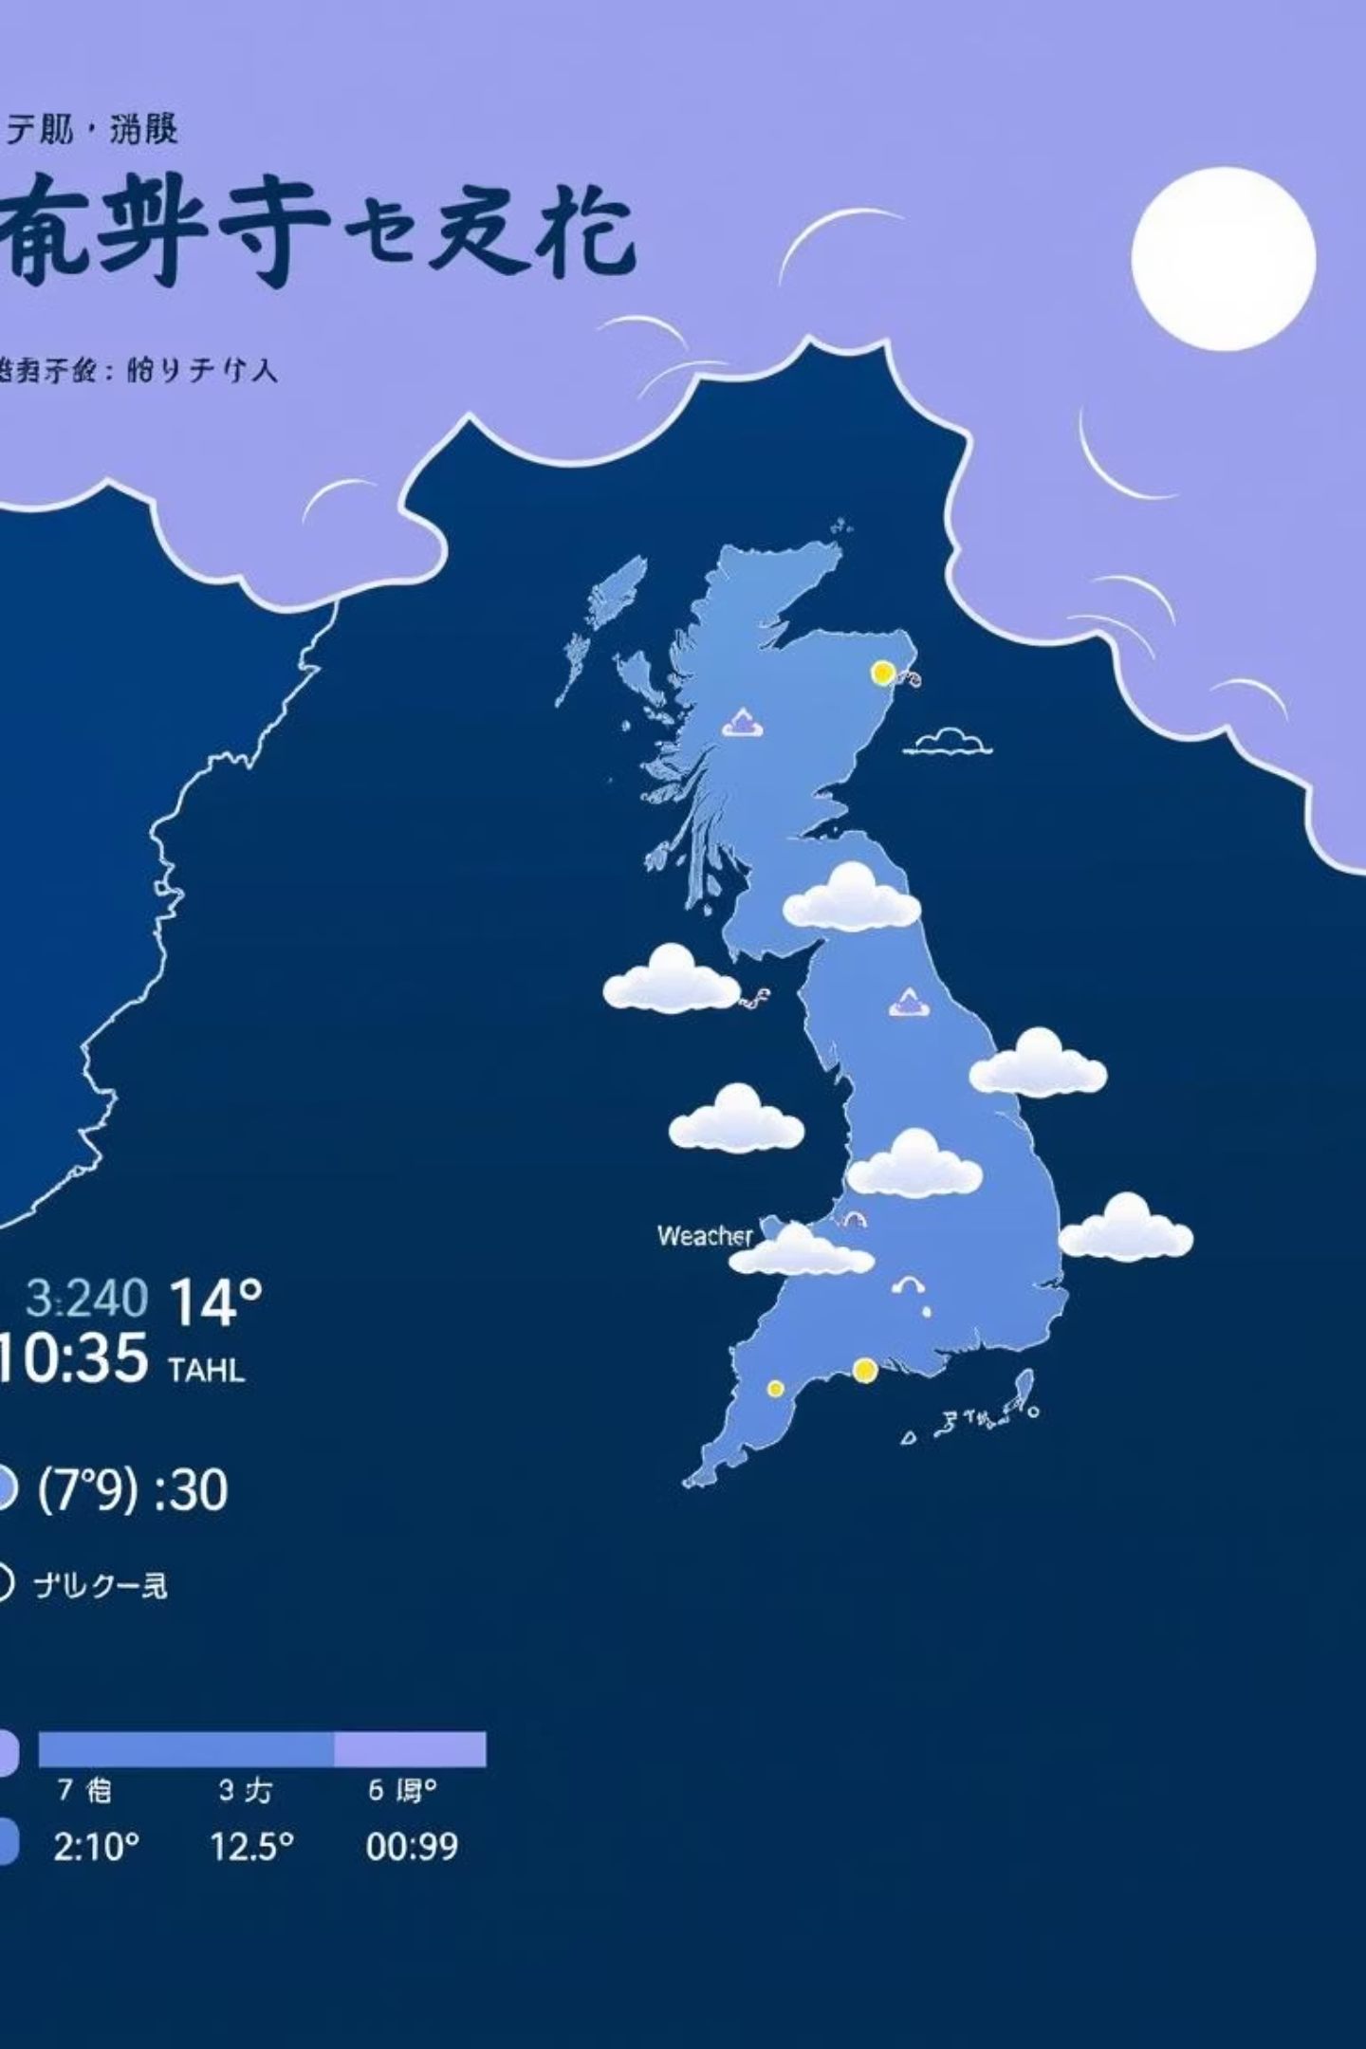
Global Weather & Climate Forecasting
Integrating NASA POWER and OpenWeather data, OCNeX trains LSTM models to detect weather patterns, predict short and long-term trends, and flag extreme events like storms and heatwaves for early warning systems.
01
Fetch Data
Retrieve temperature, precipitation, wind speed, humidity from NASA POWER API
02
Store Locally
Build historical CSV dataset on Raspberry Pi 5 SSD
03
Train LSTM
Learn weather patterns from 5+ years of data
04
Predict & Alert
Generate 10-day forecasts and extreme event warnings

Slide 9

Smart IoT Integration: Cooling & Agriculture
Indoor Cooling
BME680 & SHT31 sensors monitor temperature/humidity. Pi sends MQTT commands to ESP8266 relay controlling AC/fan when indoor temp exceeds 28°C.
Smart Agriculture
BH1750 light sensor + humidity logic triggers mist sprayer when humidity drops below 40%. TFT display shows real-time sensor values and system status.

Slide 10

System Architecture
NASA & Copernicus Sources
IoT Control Outputs
MQTT to ESP8266, Arduino relays
OCO-2, Sentinel-2, POWER
GLIMS & Ancillary Data
Visualization Dashboard
Satellite-to-IoT Pipeline
Glacier and environmental datasets
Web UI with real-time alerts
Raspberry Pi 5 Processing
AI / LSTM Models
TensorFlow time-series inference
Python, pandas, scikit-learn
Data Sources: NASA OCO-2, Copernicus Sentinel-2, NASA POWER, GLIMS glacier data. Processing: Python with scikit-learn, TensorFlow LSTM, pandas. Output: Web dashboard, real-time alerts, IoT device control via MQTT.

Slide 11
Impact & Next Steps
Real-Time Monitoring
1
Unified dashboard for carbon, forest, glacier, and weather data.
Predictive Intelligence
2
AI forecasts emerging ecological risks and emission hotspots.
Actionable Insights
3
Empower scientists, policymakers, and urban planners with data-driven decisions.
Scalable IoT Control
4
Automated cooling and agricultural systems reduce energy waste and optimize resource use.

